Slide 1
Wise Card Program — Data Analysis
Yang Xue Ming 21/3/2026

Slide 2
Methodology
Profit = interchange + conversion − fixed − variable
Tools used:
SQL (SQLite): data extraction, table building, all aggregations
Python (pandas, matplotlib): visualisation and analysis
Revenue
Interchange — inter_change_fee × rate_to_gbp
FX Spread — billing_gbp − amount_gbp (when currencies differ)
Costs
Fixed + Variable (rate × billing_gbp)
LTV CAVEAT
Only 4 months data → extrapolated as (profit/days) × 365 65% of cards never transacted → treated as £0
Data Preparation
18,596 transactions → filtered to 17,388 SUCCESS
Built txn_enriched_full via 4 SQL CTEs

Slide 3
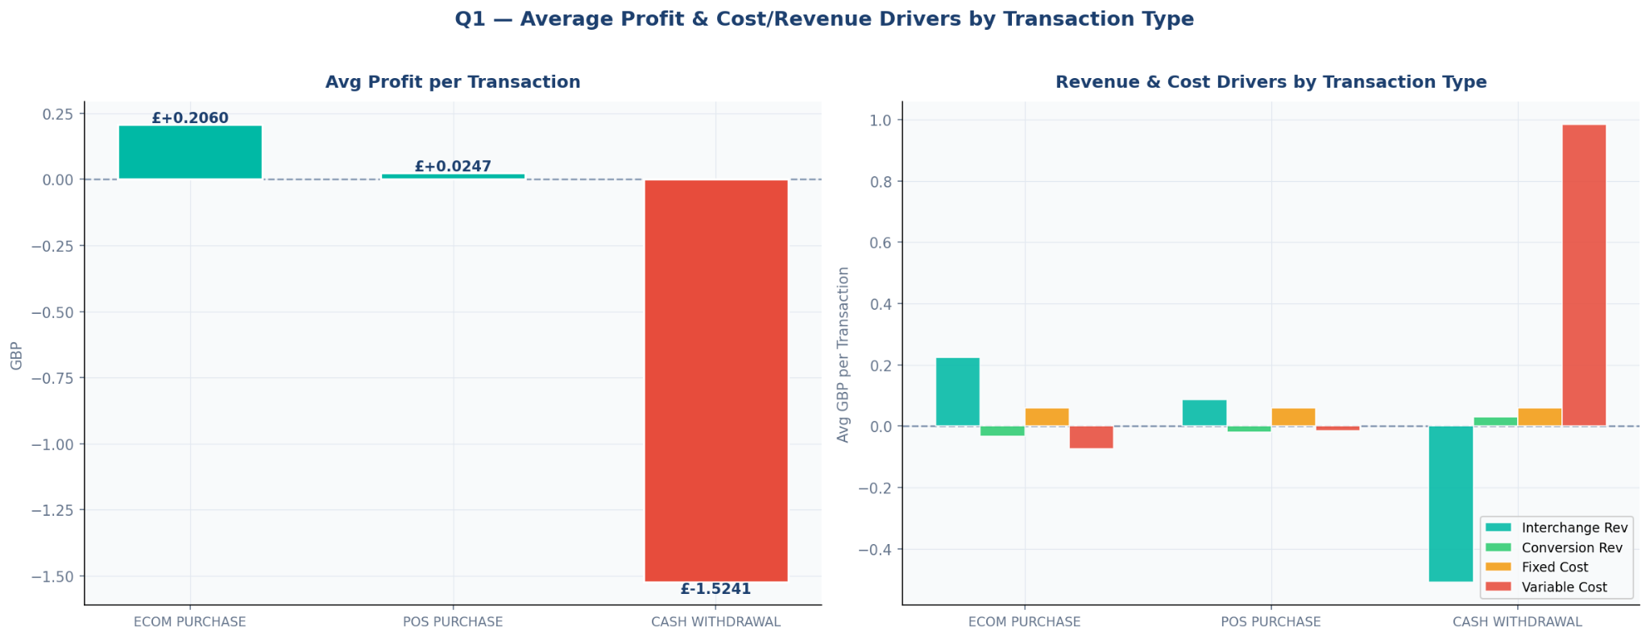
E-commerce drives profit, while ATM withdrawals are structurally loss-making
Type | # Txns | Interchange | Conv. Rev | Fixed Cost | Variable Cost | Avg Profit
ECOM Purchase | 2,790 | £0.224 | -£0.033 | £0.060 | -£0.074 | £+0.206
POS Purchase | 13,029 | £0.087 | -£0.019 | £0.060 | -£0.016 | £+0.025
Cash Withdrawal | 1,569 | -£0.510 | £0.029 | £0.060 | £0.983 | £-1.524
* Conversion revenue can be negative when the FX spread
goes against Wise (merchant rate > customer billing rate)
ECOM — best margin Strong interchange + variable cost earns back
POS — thin but reliable 75% of volume, frequency compensates
ATM — loss-making by design Negative interchange + £0.98 variable scheme fees Wise absorbs this as a customer acquisition cost

Slide 4
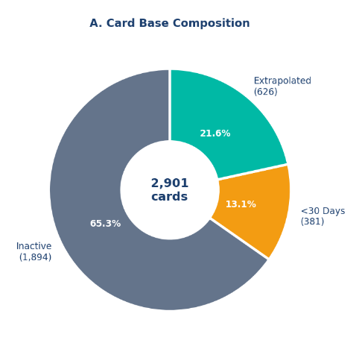
12-Month LTV Forecast: The card program is loss-making
driven by high ATM costs and low activation rates.
 | All Cards n=2901 | Active Cards n=626 | Total Loss 12M forecast
Avg 12M LTV | -£2.69 | -£11.98 | -£7802
Why is avg LTV only £-2.69?
65% of cards never transacted — pulling average toward £0
For users with very short observation windows (<30 days), annualisation would overstate LTV, so observed profit was used conservatively.
Only 4 months of data available → LTV must be extrapolated, not observed
Forecasting approach (no full 12M data available):
≥ 30 days → (profit ÷ days) × 365
< 30 days → observed profit as-is
No txns → £0
Key insight
Active customers cost £-11.98 each
Inactive cards mask the true loss
Card adoption ≠ card usage

Slide 5
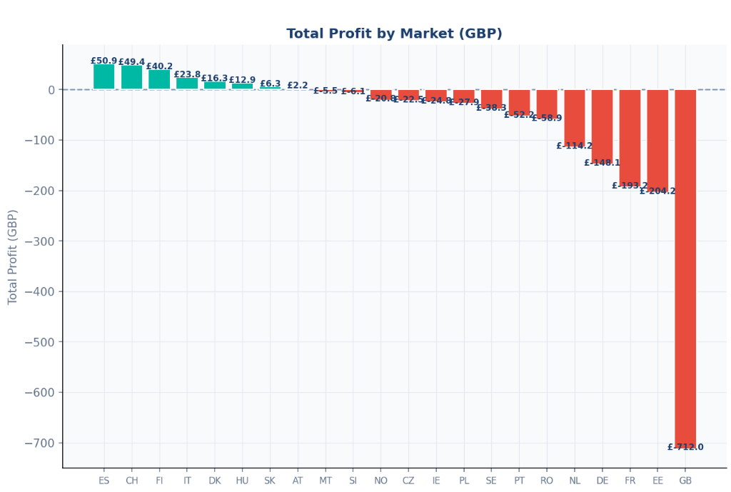
Market performance varies significantly, driven by FX usage, spend, and scale
Market | Total Profit | Avg Profit/Txn | Avg Spend | FX%
🟢 ES | £+50.9 | £+0.081 | £48.6 | 28%
🟢 CH | £+49.4 | £+0.065 | £47.9 | 15%
🟢 FI | £+40.2 | £+0.235 | £14.9 | 41%
🟢 IT | £+23.8 | £+0.069 | £43.3 | 31%
🔴 DE | £-148 | £-0.196 | £37.2 | 23%
🔴 FR | £-193 | £-0.294 | £56.9 | 15%
🔴 EE | £-204 | £-0.102 | £15.1 | 13%
🔴 GB | £-712 | £-0.087 | £33.3 | 17%
SIMILARITIES
POS dominates everywhere
Inter Region = Loss making in every market
DIFFERENCES
FX usage: RO 88% vs IE 2%
Avg spend: FR £56.9 vs SK £12.6
GB = 47% of all txns but loss making at scale
ES profitable despite 28% FX
FI highest profit/txn but tiny base

Slide 6
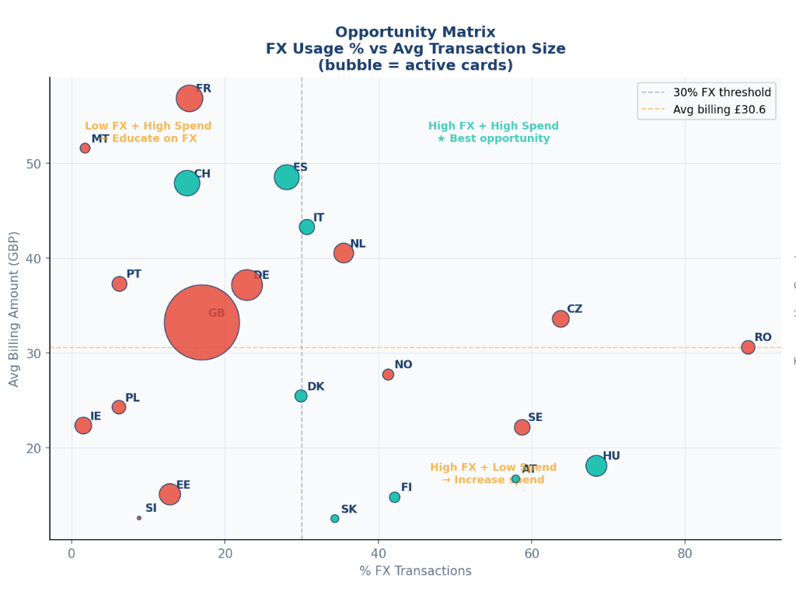
Growth Opportunity: Spain & Italy show strongest upside
 | Spain | Italy
Total Profit | £+50.9 | £+23.8
Avg Profit/Txn | £+0.081 | £+0.069
Avg Spend | £48.6 | £43.3
FX Usage | 28% | 31%
Active Cards | 51 | 19
Opportunity | Convert FX | Convert FX
ITALY/SPAIN
Citizens spend >40 GBP per transaction.
Push multi-currency features
Encourage primary card usage
Loyalty / retention
HUNGARY
Increase spend per user
Encourage higher ticket purchases, more frequent usage
ALL RED MARKETS
Reduce ATM usage, every withdrawal costs £-1.52/txn regardless of market
Profitability depends on shifting user behaviour toward digital payments and FX-generating transactions.

